Slide 1
AI-Powered Credit Scoring and Document OCR System for Loan Risk Assessment
CO-OP Project at Industry (Module-2) | Project Type: Copyright
Team: Om Tomar, Sahajpal Singh, Ridhima Chopra, Ishpreet Kaur
Supervisor/Mentor: Lalit Sharma
Best German Credit ROC-AUC
Best Lending ROC-AUC
Submission Status
0.831
0.722
GitHub Ready

Slide 2
Problem Statement
Reliable digital lending needs risk prediction and document understanding.
Manual document checks slow loan onboarding and increase operational cost.
Credit-risk models must detect risky borrowers while staying explainable.
A GitHub-verifiable package is needed for evaluation, reproducibility, and IPR readiness.
Goal
End-to-end AI workflow for loan risk assessment
Output
Runnable source code + report + PPT + IPR placeholder
Evaluation
Metrics, plots, reproducible configs

Slide 3
Objectives
Build a reproducible credit-scoring benchmark on public datasets.
Compare Logistic Regression, Random Forest, Gradient Boosting, and MLP.
Save traceable metrics, plots, confusion matrices, and feature importance.
Prepare real SROIE/FUNSD scanned-document data for PaddleOCR evaluation and fine-tuning.
Package the repository according to final evaluation instructions.

Slide 4
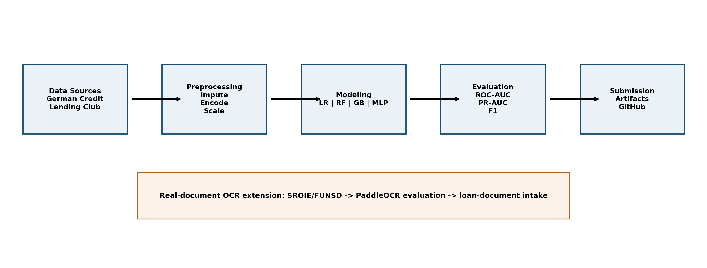
System Architecture
Credit scoring is the core decision pipeline. OCR is the real-data document-intake extension for borrower forms.

Slide 5
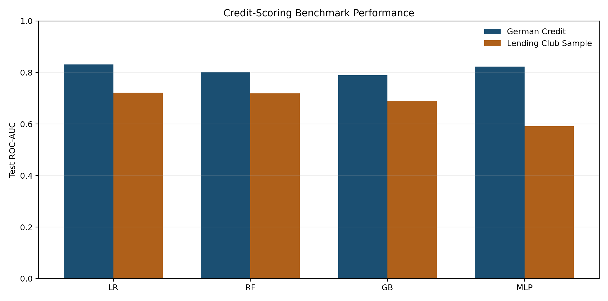
Credit-Scoring Experiment Design
Datasets: German Credit and Lending Club sample.
Preprocessing: imputation, one-hot encoding, scaling, class weighting, oversampling.
Metrics: ROC-AUC, PR-AUC, precision, recall, F1, accuracy, confusion matrix.
Explainability: feature-importance CSV and plot saved for every run.

Slide 6
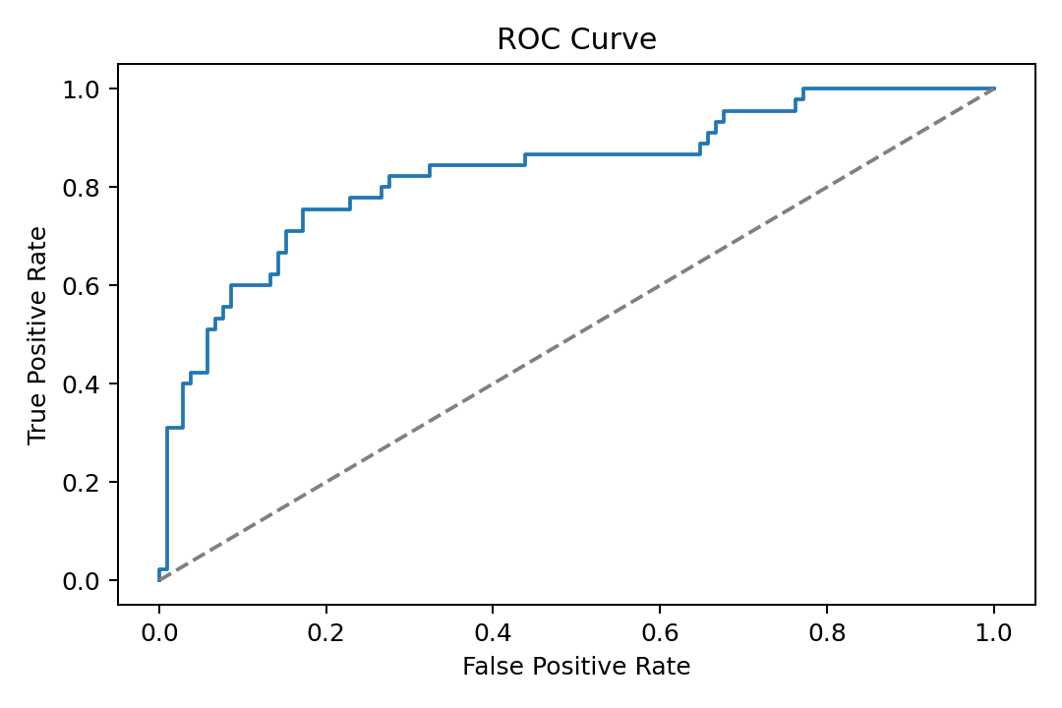
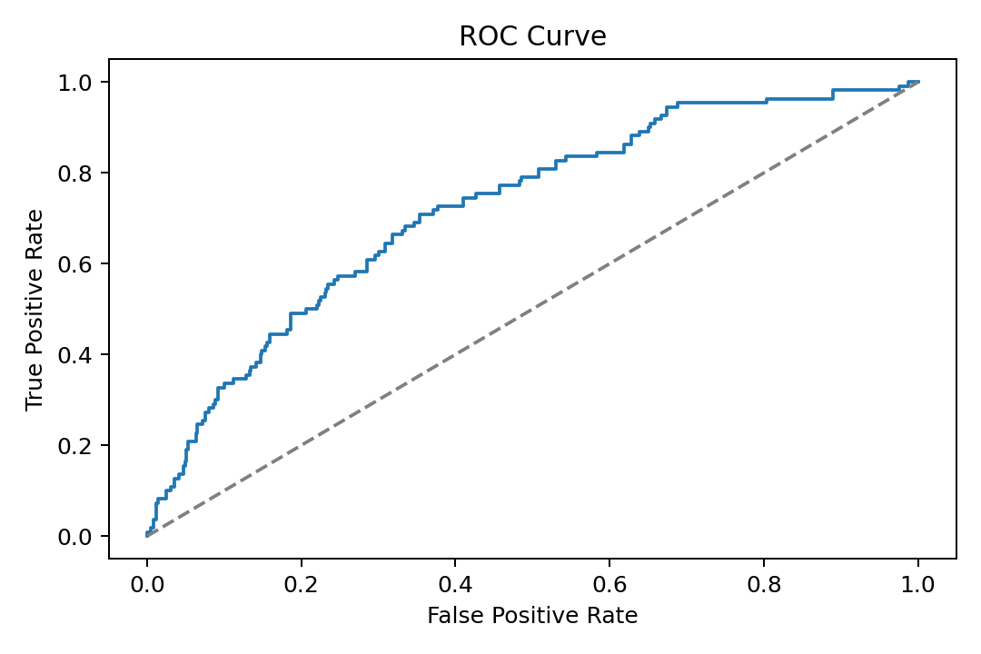
Best Credit-Scoring Results
German Credit
Lending Club Sample
Logistic Regression ROC-AUC 0.831 Recall 0.778
Logistic Regression ROC-AUC 0.722 Recall 0.682

Slide 7
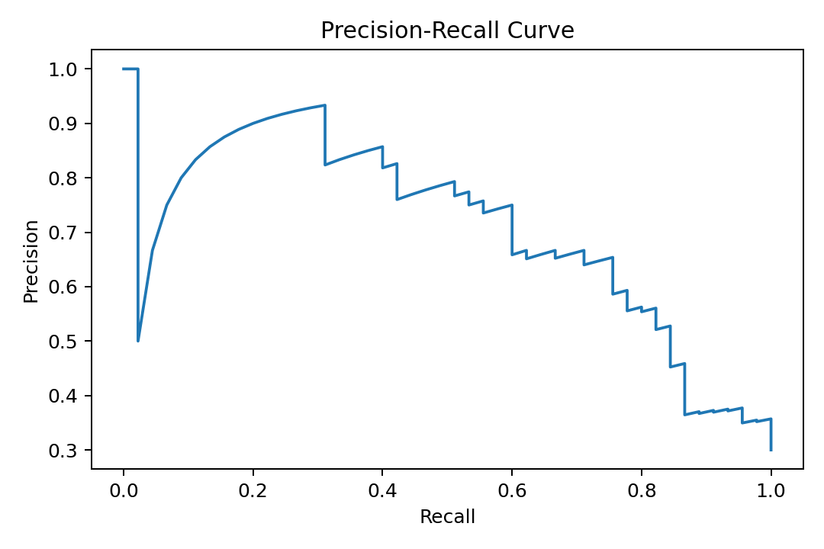
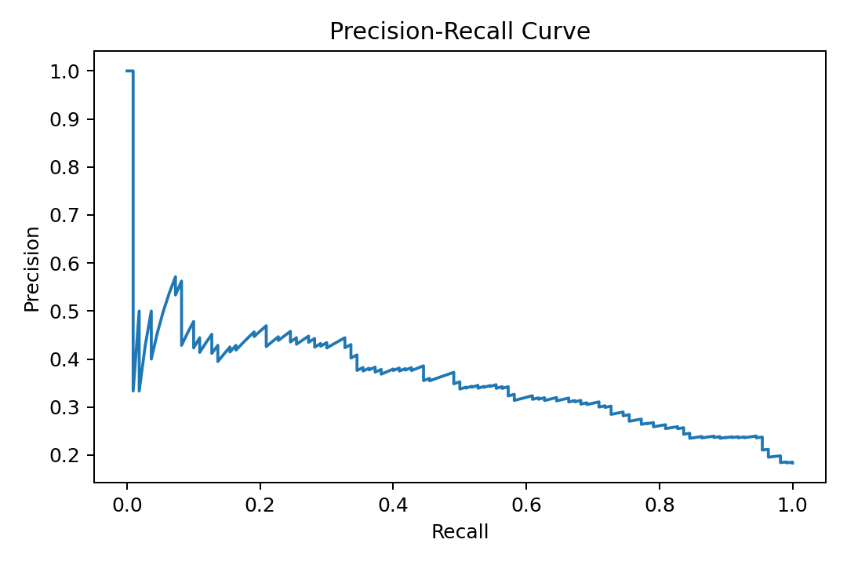
Precision-Recall Curves
Shows model behavior under class imbalance and risk-recall tradeoffs.
German Credit
Lending Club Sample

Slide 8
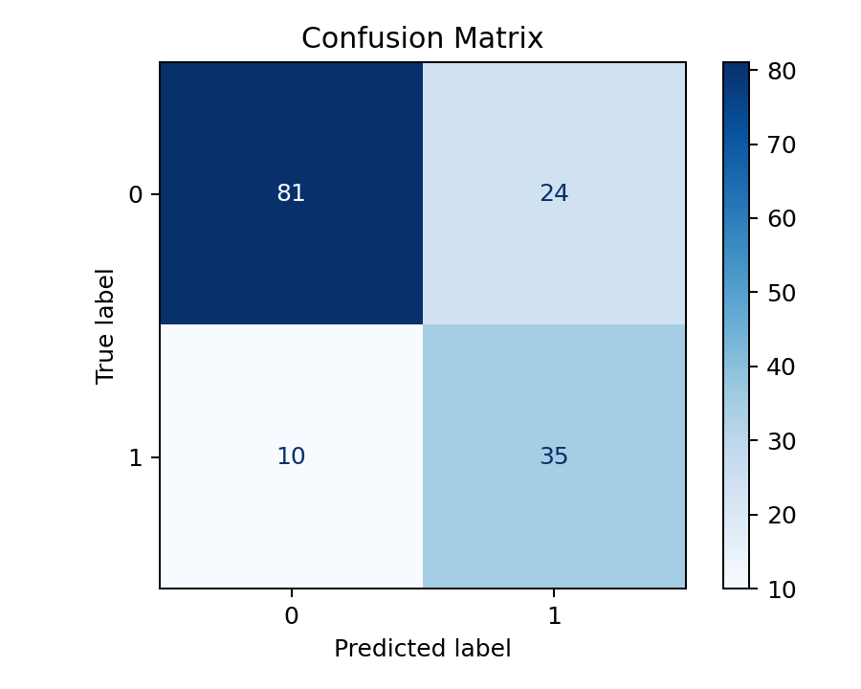
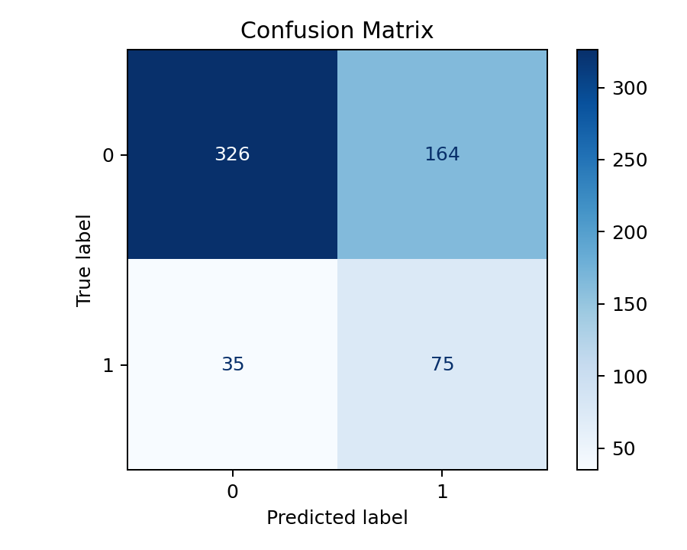
Confusion Matrix View
Held-out decisions shown as approval-risk classification counts.
These matrices make the false-positive and false-negative tradeoff visible for viva discussion.

Slide 9
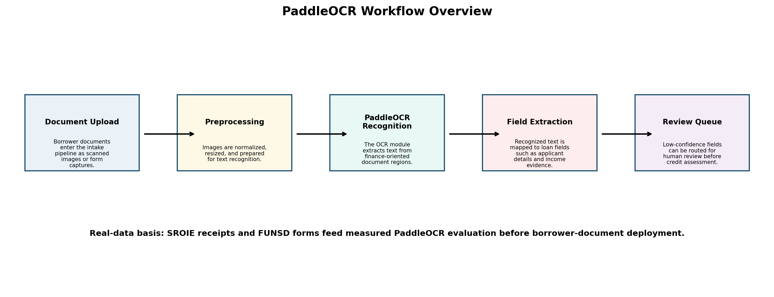
Real PaddleOCR Data Pipeline
SROIE receipts + FUNSD forms converted into PaddleOCR recognition labels.
Real scanned-document sources: ICDAR2019 SROIE and FUNSD.
Converter exports train/validation/test labels for PaddleOCR SimpleDataSet.
Baseline metrics are included only when generated from saved evaluation artifacts.
Real SROIE/FUNSD OCR pipeline status: prepared_real_dataset. Prepared recognition crops: train: 1200, val: 300, test: 300.

Slide 10
Measured OCR Baseline
Traceable to artifacts/ocr/real_ocr_finetune/baseline.
Samples
CER
Word Accuracy
Exact Match
25
0.110
0.691
0.440
Evaluation uses held-out real scanned-document crops prepared from public datasets.
The same test labels can be reused after fine-tuning for baseline-vs-fine-tuned comparison.
Borrower-document deployment should add privacy-reviewed labeled financial forms.

Slide 11
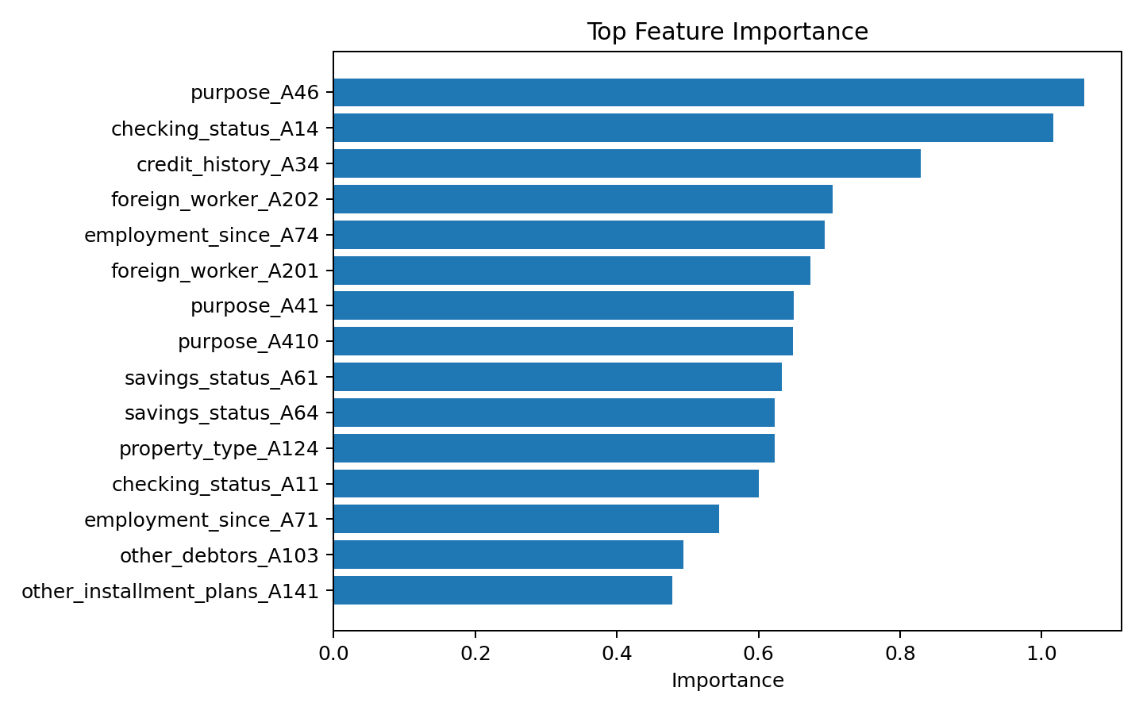
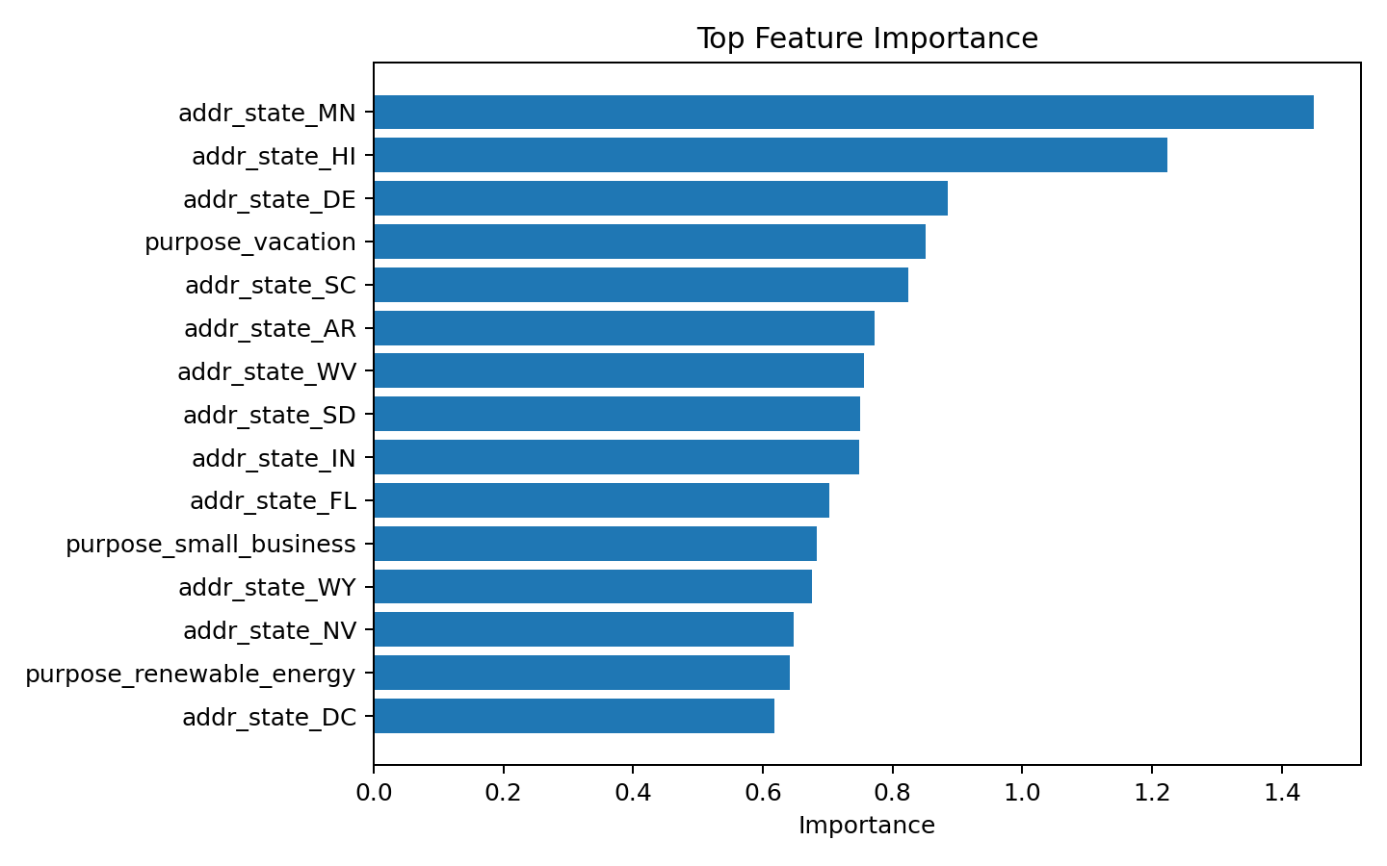
Explainability And Traceability
Feature importance is exported for both benchmark datasets.
Feature-importance artifacts are generated for every benchmark run.
Metrics are exported as JSON and summarized in CSV.
Final report values can be traced to saved repository artifacts.

Slide 12
GitHub Submission Structure
IPR Submission Proof: placeholder for copyright form and screenshot.
Report and PPT: final DOCX, PPTX, templates, markdown, and figures.
Source code: runnable code, configs, tests, data samples, and artifacts.
README.md: team details, project type, status, and run instructions.

Slide 13
Evaluation Readiness
Mapped directly to the final marking areas.
Filing Status
Platform Compliance
IPR proof folder and copyright placeholder
Required GitHub folders and runnable code
Revision Handling
Supervisor Updates
Report, PPT, README, figures, templates, generator
Progress and feedback reflected in final documentation
Repository is organized for external verification.
Final documents explain the project, evidence, run commands, and submission status.

Slide 14
Conclusion And Future Scope
Delivered a reproducible AI-based loan risk assessment package.
Credit-scoring benchmark identifies strong transparent baselines.
OCR workflow shows practical document-intake extension potential.
Future work: larger Lending Club experiments, SHAP explanations, scanned-form OCR evaluation, and API deployment.

Slide 15
Thank You
AI-Powered Credit Scoring and Document OCR System for Loan Risk Assessment
Team: Om Tomar | Sahajpal Singh | Ridhima Chopra | Ishpreet Kaur
Department of Computer Science and Engineering, Chitkara University

